Slide 1
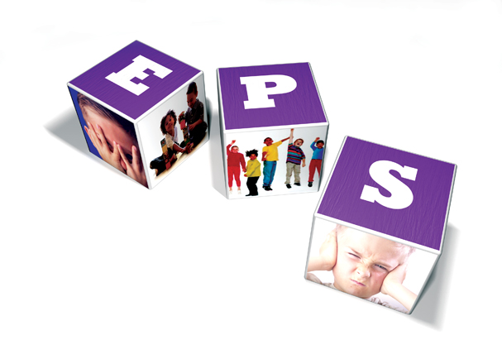
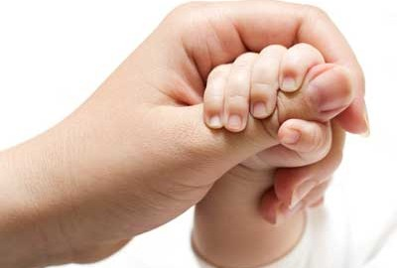
E D U C A T I O N A L P S Y C H O L O G Y S E R V I C E
Attachment Theory
Cookham Rise
Parent session
June 2019
Scott I-Patrick

Slide 2


Innate priorities.
E D U C A T I O N A L P S Y CH O L O G Y S E R V I C E
5 fulfilment needs
Higher level needs
4 esteem needs
3 social needs
2 safety needs
Basic needs
1 physiological needs
Maslow’s hierarchy of needs

Slide 3
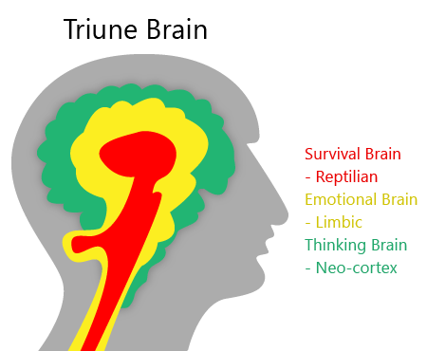

E D U C A T I O N A L P S Y C H O L O G Y S E R V I C E
Reptilian brain is about avoiding harm and seeking resource for sustenance
Mid-brain is centre for emotion
Prefrontal-cortex for thinking
(Paul MacLean)

Slide 4
Training Guidelines
E D U C A T I O N A L P S Y C H O L O G Y S E R V I C E
This training material may touch on your own emotions and experience. Please take care of yourself and tend to your own needs.
If you would like to raise a case for discussion or questions, please be sensitive to each other’s feelings.

Slide 5
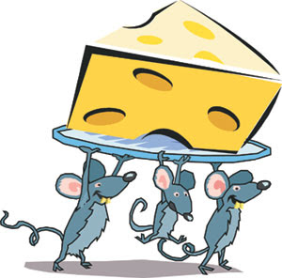
The Story of the Three Mice
First mouse – each time he pressed the button a tasty morsel of food was delivered.
Second mouse – faulty button delivered food inconsistently.
Third mouse – Button didn’t work at

Slide 6
E D U C A T I O N A L P S Y C H O L O G Y S E R V I C E
What is attachment?
The bond between a caregiver and a child
The relationship a child makes with an adult in response to caregiving
A pattern that affects us all and determines how safe we feel.
Woven in to the pathways of our brain in the earliest phase of life.

Slide 7
E D U C A T I O N A L P S Y C H O L O G Y S E R V I C E
Dimensions of caregiving
Attachment theory outlines how the internal life of a child is organised around the early experiences of caregiving received.
There are various dimensions to caregiving

Slide 8
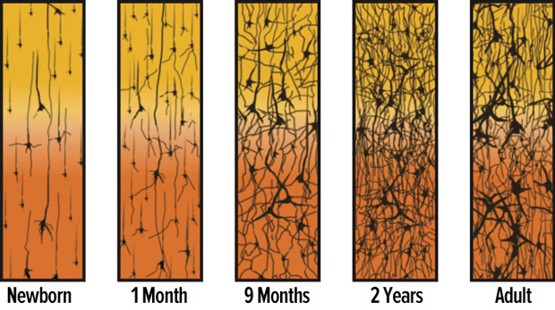


Slide 9
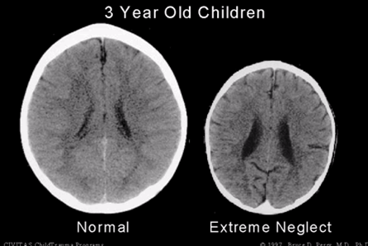
Neuroscience
Difficulties remaining calm
Difficulties learning and taking on information
Difficulties with emotional regulation

Slide 10
E D U C A T I O N A L P S Y C H O L O G Y S E R V I C E
Dimensions to caregiving
Positive | Negative
Sensitivity - mother recognises baby’s needs and responds appropriately to his signals | Insensitivity -mother fails to reads baby’s signals and interacts according to her own needs and wants
Acceptance – mother accepts her responsibilities, responds to baby’s needs, and acknowledges that parenthood involves constraints on her lifestyle and behaviour. She accepts her baby regardless of his mood. | Rejection – mother resents the emotional demands made on her by baby, and rejects the baby. She may feel guilty about this and become irritable with baby’s refusal to be satisfied and responsive to her.
Cooperation – mother recognises, supports and respects her baby’s autonomy and appears to ‘co-operate’ with his needs and accomplishments. | Interference – mother does not recognise or respect baby’s independence and seeks to define his experience. Mother is often abrupt, impatient and aggressive.
Accessibility – mother is physically and emotionally available and accessible to baby | Ignoring – mother is either physically or emotionally unavailable and with-holding

Slide 11
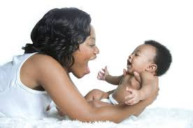
Positive dimension to care giving
E D U C A T I O N A L P S Y C H O L O G Y S E R V I C E
I feed, nourish and nurture you with my whole self
CONTAINMENT: I hold your whole being in mine and reflect your experience back to you in manageable doses whilst soothing you
ATTUNEMENT: I tune in to what you are feeling so I can meet your every need.
REGULATION: My physiology matches yours and calms you. I use my tone of voice and my person to calm you.
TOLERATION: I help you to tolerate your feelings and sensations.
SAFETY: I keep you safe from harm and protect you from any impingement on your growing self so that you know you are a whole and beautiful human being.
Every interaction between us is helping me to organise my experiences of the world so I can build a model of how to relate to everyone and everything outside of me.
SENSE OF SELF: I feel completely connected to you and don’t know where I start or end. You help me to understand I am a separate human being who exists continuously through time. I see in your eyes and your manner who I am and whether I’m loveable.
TOLERATION AND REGULATION: There are all these sensations and feelings in me and I can’t hold them. I give them all to you and learn about them by how you respond. Pathways are created in my brain so I know how to deal with these feelings throughout my life.
SAFE BASE: You keep me safe and make the world safe for me. I learn from you how to manage challenges.
INTEGRATION: You make sense of the world for me and feed back the thoughts, feelings and wishes behind my behaviour so that I understand I have an inner realm of experience. From this I learn how to think.
Notes:
Leads to

Slide 12
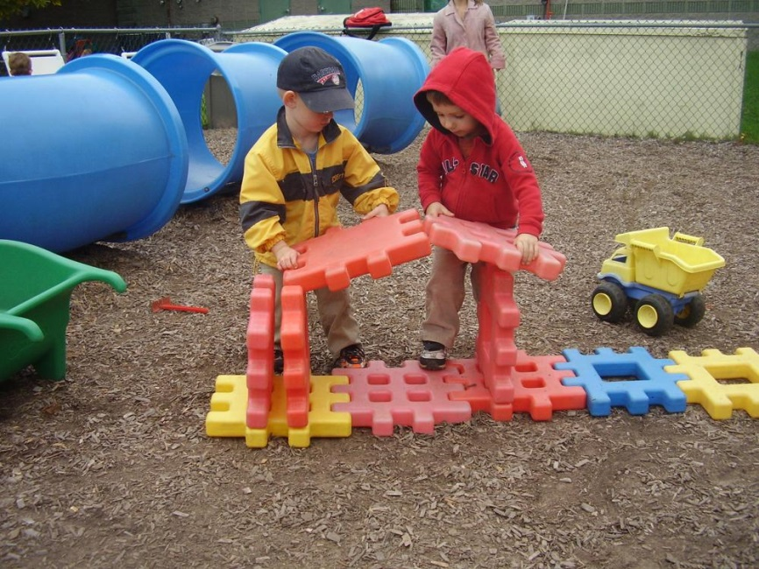

Securely attached children:
View the world as a safe place and view other people as a source of nurture & support
View themselves as worthy of attention and when they encounter difficulties, are more likely to seek help
Better problem solvers and more curious
Have increased quality and duration of learning
More socially empathetic and less biased in interpreting behaviour of others
Self – aware and more empathetic

Slide 13

Meet baby Kontent!
E D U C A T I O N A L P S Y C H O L O G Y S E R V I C E
I live in a nice house with my parents who work together and support each other and me
My mum has always understood what I am thinking and feeling. She plays with me and helps me to understand what is going on inside me and in the world around me
My dad takes me out to explore and introduces me to new and exciting things
When there is a problem, my mum understands how that feels for me and always finds a solution
My mum and dad enjoy being with me and tell me how much they love me. They delight in what I do well and my successes.
I trust my needs will be met and adults are capable of and happy to take care of me
I trust I have the ability to learn and live in the world
I have confidence in my thoughts and actions
I find it easy and fun to learn and make mistakes along the way
I see the world out there as safe and exciting
When something is hard I ask for help and know it will be given
I am a good boy who is easy to love
I can succeed in life and it is noticed and celebrated.

Slide 14
Negative dimension to care giving
E D U C A T I O N A L P S Y C H O L O G Y S E R V I C E
Consistently insensitive parenting
Inconsistently insensitive parenting
Abusive caregiving
Breaks in caregiving
Unmanaged stresses
Traumatic episodes
I have no faith in adults to meet my needs.
I do not know how to learn, I am just surviving however I can.
I am a bad child that nobody can like or love.
The world is unsafe and new situations are scary.
Learning is unknown and dangerous and may expose me.
When something is hard I handle it my own way because nobody helps me.

Slide 15
Insecure Attachment
These children can appear:
- Unfocussed Disruptive
- Controlling
- Withdrawn
- Destructive
Punished/excluded.
Difficulties forming relationships

Slide 16
The Picture on Attachment
E D U C A T I O N A L P S Y C H O L O G Y S E R V I C E
55-65% (approx.) of the UK population are securely attached
What about the other 35-45%?
        Stats from Keys Attachment Centre, 2009

Slide 17
The Picture on Attachment
E D U C A T I O N A L P S Y C H O L O G Y S E R V I C E
The other 35-45% are argued to develop an insecure attachment style
Insecure attachment models
      Avoidant (approx 15-23%)
      Ambivalent (approx 8-12%)
      Disorganised (approx 10-15%)

Slide 18
E D U C A T I O N A L P S Y C H O L O G Y S E R V I C E
Manifestation of early care giving experiences
Two dimensions:
Internal constellation – working model
External manifestation - Behaviour
Behaviour is driven by the internal working model

Slide 19
E D U C A T I O N A L P S Y C H O L O G Y S E R V I C E
Internal working model
A child’s experience of caregiving helps create;
A working model to help the child survive
A map of the self and of the world which is needed in order to be able to predict, control and manipulate the environment.’
An internal model that consists of the child’s concept of self, others, the world and relationships

Slide 20
E D U C A T I O N A L P S Y C H O L O G Y S E R V I C E
Internal working model
Internal Working Model (organised mental representations of the self and others)
Positive | Negative
Self I am worthwhile I am safe I am capable | Self I am worthless I am unsafe I am impotent
Carers/others They are available They are responsive They meet my needs | Carers/others They are unresponsive They are unreliable They are threatening They are dangerous They are rejecting

Slide 21
E D U C A T I O N A L P S Y C H O L O G Y S E R V I C E
External Manifestation - Behaviour
Understanding the insecure patterns of attachment and associated behaviour

Slide 22
E D U C A T I O N A L P S Y C H O L O G Y S E R V I C E
BEHAVIOUR HAS MEANING
A trigger activates the attachment system and generates attachment behaviours to bring the attachment figure close and restore a sense of safety

Slide 23
E D U C A T I O N A L P S Y C H O L O G Y S E R V I C E
“The less secure child may have so much uncertainty about the availability of the attachment figure that he/ she is preoccupied with keeping proximity to the detriment of exploration activity”
(Ainsworth et al)

Slide 24
Avoidant
E D U C A T I O N A L P S Y C H O L O G Y S E R V I C E
Organised around
  Caregiving: consistent unavailability of mother and needs consistently not met (e.g. depressed mother, preoccupied mother, emotionally dismissive or avoidant mother)
  Internal Working model: others are not available and reject me. I will try not to need them even though I do; I cannot be helpless or be reminded of my own vulnerability. There must be something wrong with me for my mother to reject me. I am so angry and scared but know I have to rely on myself and nobody else.
  Behaviours: avoid or ignore contact with the attachment figure and seek to manage self, usually by denying and suppressing feelings, trying to get away from the situation, or directing anger elsewhere.
Indicators in school: Withdrawn, socially isolated, appears self-sufficient, rejects or avoids help, bullying others, cannot tolerate vulnerability or positive praise.

Slide 25
Ambivalent
E D U C A T I O N A L P S Y C H O L O G Y S E R V I C E
Organised around
  Caregiving: responses to child’s needs are inconsistent and intrusive, and needs consistently not met (e.g. emotionally insensitive and misattuned mother, overwhelming and unresolved needs in the mother taking precedence over the child’s needs)
  Internal Working model: I cannot trust another to meet my needs and yet I cannot be alone. I need to constantly read what is going on around me so that I can adapt and keep people close. My value in this world lies in how valuable I am to another, and yet I can become really angry that others don’t see ME. I need to be close to someone in order to hold myself together and I am scared I will disintegrate without them.
  Behaviours: Seeking proximity and resisting separation yet anxious even when in caregiver’s presence….Ambivalence -actively seeks closeness with over-clingy and submissive behaviours towards the caregiver, and then becomes angry, rejecting and controlling of them.
Indicators in school: Poor school attendance, frequent illness (emotions are experienced bodily – ‘somatised’ – rather than endured), anxiety, wanting an adult close all the time, inappropriate boundaries (enmeshing), taking care of others (including the teacher), controlling and bossy behaviour, hostility towards teacher.

Slide 26
Disorganised
E D U C A T I O N A L P S Y C H O L O G Y S E R V I C E
Disorganised
  Caregiving: Inconsistency in the caregiving and environment as a whole where relationship is dominated by high levels of stress and distress (e.g. abusive or neglectful caregiving, periods of major pre-occupation or emotional absence, abandonment, frequent change and/or lack of continuity in caregiving)
  Internal Working model: I am bad and not at all worthy of love or care. The world is dangerous and hostile and nobody cares about me. I have to survive at whatever cost
  Behaviours: Disorientated and not consistent. Elements of avoidant and ambivalent styles evident but in no predictable pattern. Considerable hyper-vigilance in the face of uncontained anxiety and fear. High state of arousal with no means of regulating – behaviour entirely focused upon survival and defending against overwhelming fear and uncertainty (from inside and outside self).
Indicators in school: Looked after child, poor memory and concentration, intense anxiety, always on alert and distracted by slightest thing, aggression and violence, anger/rage, lack of empathy, insensitivity to others, bullying, trouble making, stealing, sudden eruption of behaviour, over-sensitive to criticism or correction, never seems happy or settled.

Slide 27
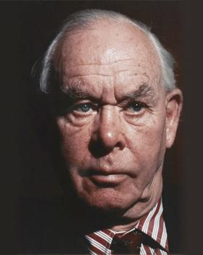
Attachment Theory – in a nutshell
John Bowlby (1988):
“lasting psychological connectedness between human beings”
Multiple attachments can occur with other adults throughout the lifespan, although early experiences may continue to have an impact.
Secure attachments support mental processes (mental representations the internal working model) that:
Regulate emotions
Reduce fear
Attune to others
Have self-understanding and insight
empathy for others
appropriate moral reasoning
Insecure attachments may mean child cannot rely on an adult to respond to their needs in times of stress, they are unable to:
Soothe themselves
Manage their emotions
Engage in reciprocal relationships

Slide 28
E D U C A T I O N A L P S Y C H O L O G Y S E R V I C E
Summary
Attachment is…
A living breathing pattern that affects us all throughout the lifespan and determines how safe we feel.
Woven in to the pathways of our brain in the earliest phase of life and determines to a great degree our capacity for learning
A response to the caregiving received as a baby and a means of survival in that early ‘holding environment
Represented in our thoughts, feelings and wishes by an internal working model which shapes our behaviour.
How we learn to think, understand and make sense of the world. It determines our attitude towards exploring the unknown.
The organising principle for a set of thoughts, feelings and beliefs and a system of behaviours which can be activated by particular triggers at any point in time.
Secure for 55-65% of the population and insecure for the rest, be it either avoidant, ambivalent, or disorganised

Slide 29
E D U C A T I O N A L P S Y C H O L O G Y S E R V I C E
If a duck walks like a duck, talks like a duck, behaves like a duck…..
…..it must be a duck
Our knowledge & experience of ducks tell us what to expect from the duck and how to relate to it

Slide 30
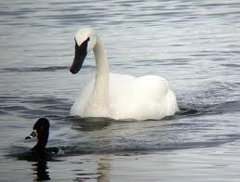
But what if the duck thinks it’s a swan?
It’s not what children do, but why they do it that is crucial to being able to relate effectively and intervene successfully.

Slide 31

E D U C A T I O N A L P S Y C H O L O G Y S E R V I C E
References
Barna,G. (2007) Revolutionary Parenting: What Research Shows Really Works. Ventura, C.A:Barna Group
Cameron,R.J & Maginn,C (2009) Achieving Positive Outcomes for Children in Care. Sage Publications
Child Cruelty in the UK 2011. www. nspcc.org.uk
Child Welfare Information Gateway
DCSF: Children Looked After in England
Geddes, H. (2006) Attachment in the Classroom. Worth Publishing
Golding,K et al (2008) Thinking Psychologically About Children who are Looked After and Adopted. Wiley
Hughes,D. (2006) Building the Bonds of Attachment. Jason Aronson
Pearce, C. (2009) Attachment & Attachment Disorder. Jessica Kingsley Publishers
Perry, A. (2009) Teenagers and Attachment. Worth Publishing

Slide 32
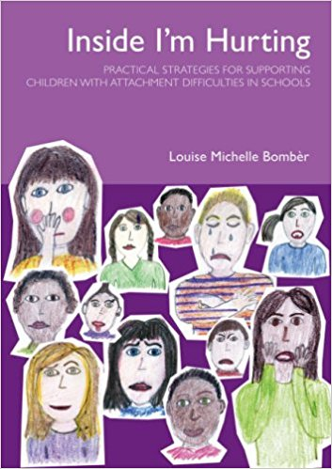
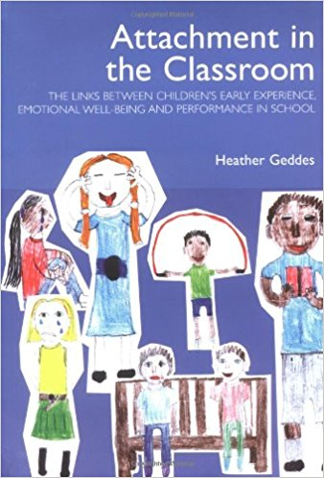

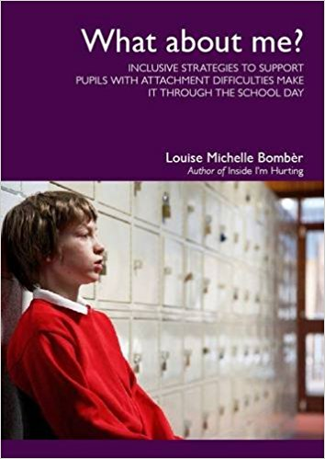
Resources

Slide 33
E D U C A T I O N A L P S Y C H O L O G Y S E R V I C E
Thank you

